Slide 1
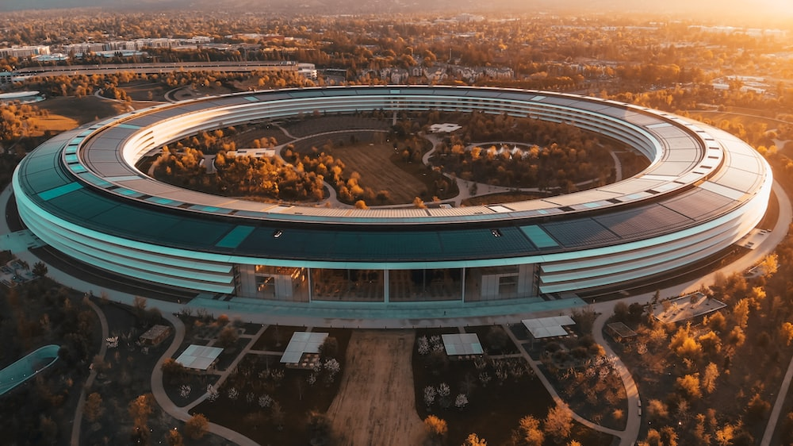
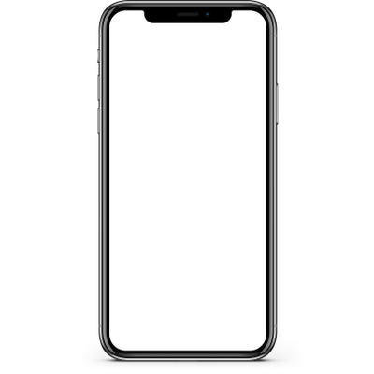

Slide 2
iPhone
Sales
Analysis

Slide 3



TEAM MEMBERS

Slide 4
TEAM MEMBERS
Pardha Sai Venkatesh
AP21110010749

Slide 5
TEAM MEMBERS
Rohith Reddy
AP21110010750

Slide 6
TEAM MEMBERS
JayaKrishna SaiCharan
AP21110010777

Slide 7
TEAM MEMBERS

Slide 8
01
INTRODUCTION
02
ABSTRACT
TABLE OF
CONTENTS
03
SYSTEM REQUIREMENTS
04
DATA VISUALISATION
05
OBJECTIVES
06
CONCLUSION

Slide 9
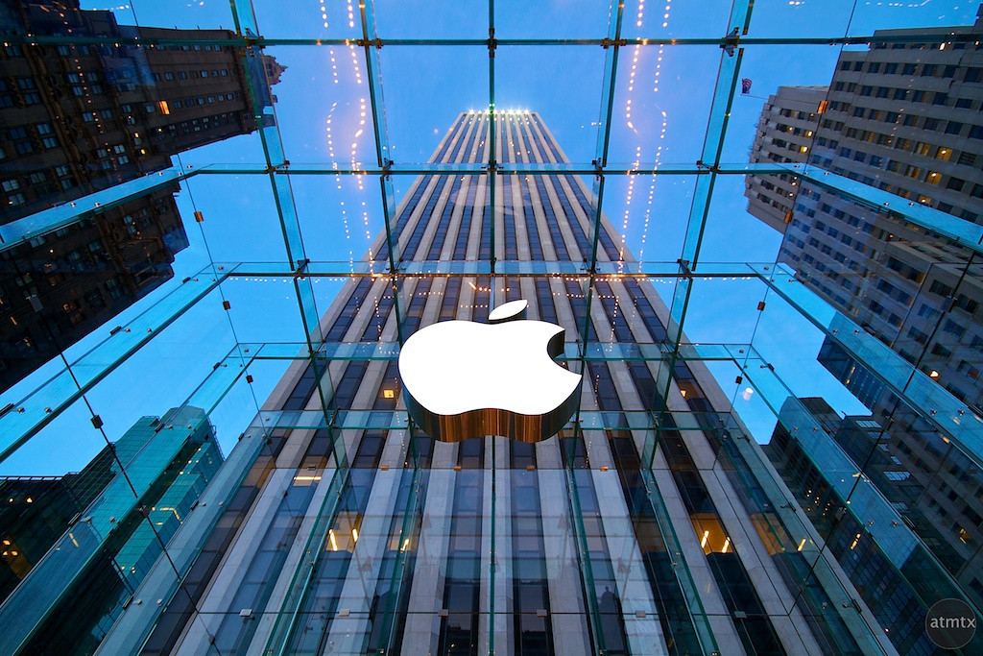
INTRODUCTION
The purpose of this study is to conduct a comprehensive iPhone sales analysis, examining sales performance, market dynamics, and consumer behavior over a specified period. Leveraging a diverse and meticulously curated dataset from authoritative sources, we delve into the intricacies of iPhone sales to provide valuable insights for industry stakeholders and decision-makers.

Slide 10
ABSTRACT
This iPhone Sales Analysis project explores sales trends, marketing effectiveness, and consumer preferences surrounding Apple's iconic iPhone. Utilizing diverse datasets and advanced techniques, the study provides valuable insights for strategic decision-making, empowering businesses to optimize strategies and maintain a competitive edge in the dynamic smartphone market.

Slide 11
SYSTEM REQUIREMENTS
HARDWARE REQUIREMENTS | SOFTWARE REQUIREMENTS
Computer: Any Modern computer or Laptop | Operating Systems: Windows, MacOS Or Linux
Processor: A Multi core processor such as Intel core i5 or above | Python: Python 3.11
RAM: At least 8GB RAM and maximum 16GB is recommended | IDE: Jupyter notebook or Google collab

Slide 12
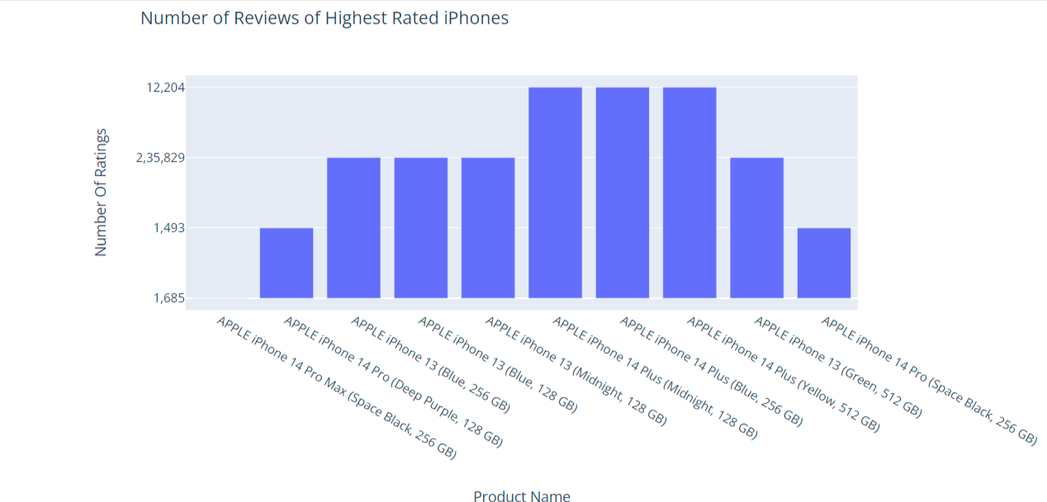
DATA VISUALISATION

Slide 13
OBJECTIVES
01
Evaluate the sales performances of different iPhone models across platforms and time periods
02
Identify the most influential marketing campaigns that contributed to increased sales and consumer engagement
03
Examine the correlation between product features, pricing, and customer preferences in driving purchase decisions
04
Investigate the impact of external factors such as economic conditions and competitor offerings, on iPhone sales

Slide 14
OBJECTIVES
01
Evaluate the sales performances of different iPhone models across regions and time periods
02
Identify the most influential marketing campaigns that contributed to increased sales and consumer engagement
03
Examine the correlation between product features, pricing, and customer preferences in driving purchase decisions
04
Investigate the impact of external factors such as economic conditions and competitor offerings, on iPhone sales

Slide 15
OBJECTIVES
01
Evaluate the sales performances of different iPhone models across regions and time periods
02
Identify the most influential marketing campaigns that contributed to increased sales and consumer engagement
03
Examine the correlation between product features, pricing, and customer preferences in driving purchase decisions
04
Investigate the impact of external factors such as economic conditions and competitor offerings, on iPhone sales

Slide 16
OBJECTIVES
01
Evaluate the sales performances of different iPhone models across regions and time periods
02
Identify the most influential marketing campaigns that contributed to increased sales and consumer engagement
03
Examine the correlation between product features, pricing, and customer preferences in driving purchase decisions
04
Investigate the impact of external factors such as economic conditions and competitor offerings, on iPhone sales

Slide 17
CONCLUSION
The iPhone Sales Analysis has provided a comprehensive understanding of the iPhone market, unraveling critical insights for businesses and stakeholders. Through data-driven examination of sales performance, consumer behavior, and market trends, we have identified the best-selling iPhone models, effective marketing strategies, and key drivers of consumer preferences

Slide 18
THANK YOU!

